Slide 1
Experimenting an approximation algorithm for the LCS
Paola Bonizzoni, Gianluca Della Vedova ., Giancarlo Mauri
Discrete Applied Mathematics 110 (2001) 13–24
Date : Nov. 19, 2004

Slide 2
Abstract
The problem of finding the longest common subsequence (lcs) of a given a set of sequences over an alphabet Σ occurs in many interesting contexts, such as data compression and molecular biology, in order to measure the “similarity degree” among biological sequences. Since the problem is NP-complete in its decision version (i.e. does there exist a lcs of length at least k, for a given k?) even over fixed alphabet, polynomial algorithms which give approximate solutions have been proposed. Among them, Long Run (LR) is the only one with guaranteed constant performance ratio.

Slide 3
In this paper, we give a new approximation algorithm for the longest common subsequence problem: the Expansion Algorithm (EA). First of all, we prove that the solution found by the Expansion Algorithm is always at least as good as the one found by LR.Then we report the results of an experimentation with two different groups of instances, which show that EA clearly outperforms Long Run in practice.

Slide 4


The Expansion Algorithm
ex:
S:{aabbaabcbc; abbbbcbbabbaa; bcabbbab}
{(a; 2)(b; 2)(a; 2)(b; 1)(c; 1)(b; 1)(c; 1),
(a; 1)(b; 4)(c; 1)(b; 1)(a; 1)(b; 2)(a; 2),
(b; 1)(c; 1)(a; 1)(b; 3)(a; 1)(b; 1)}

Slide 5
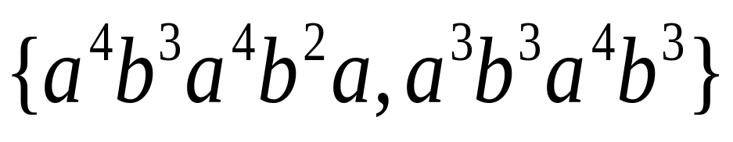
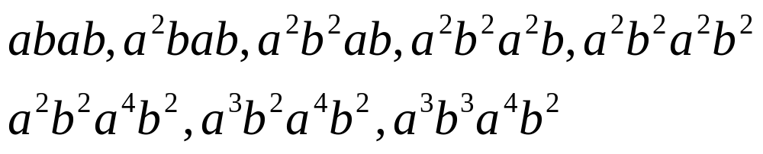
The Expansion Algorithm
Expand procedure:
obtain a common subsequence
ex:
Let S be the set
Expand:

Slide 6
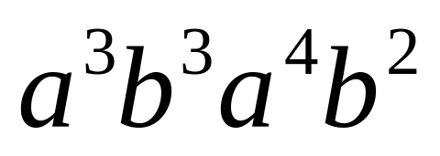
The Expansion Algorithm
Binary alphabet
ex: S
Expansion Algorithm : length=12
Long Run : a⁷
Arbitrary alphabet
Expend

Slide 7

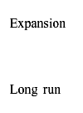
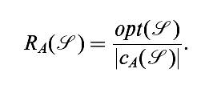

Experimental analysis
:performance ratio
:the common subsequence which is returned as a solution by an
approximation algorithm A
:optimum

Slide 8
Conclusions
In the paper, we have described the Expansion Algorithm (EA), a new approximation algorithm for the longest common subsequence problem, and we have shown experimentally that it performs better than Long Run on the average.

